Slide 1

Round Robin 4 Results:
Conditions Specific Power Curves
PCWG
9th Meeting: 12 December 2014 - Glasgow

Slide 2
RR4 Results – Conditions Specific Powers Curves
Two Exercises:
4a Conditions Specific Power Curves
4b Conditions Specific Power Curves and Turbulence Renormalisation
7 participants submitted results

Slide 3
Exercise 4a – Site Specific Powers Curves
Site Conditions
0.35
Power Curve A
Power Curve B
0.20
Shear Exponent
Power Curve C
Power Curve D
0.05
6%
10%
14%
Turbulence Intensity

Slide 4
Exercise 4b – Site Specific Powers Curves & Turbulence Correction
Site Conditions
0.35
Power Curve A
Power Curve B
0.20
Shear Exponent
Power Curve C
Power Curve D
0.05
6%
10%
14%
Turbulence Intensity

Slide 5
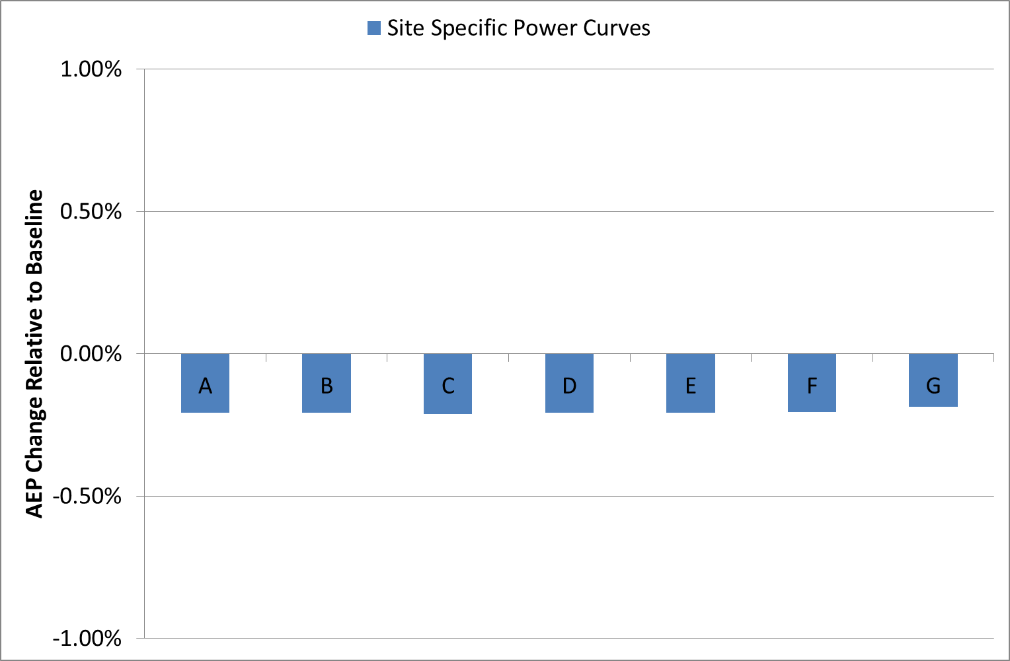
RR4 Results – Site Specific Powers Curves

Slide 6
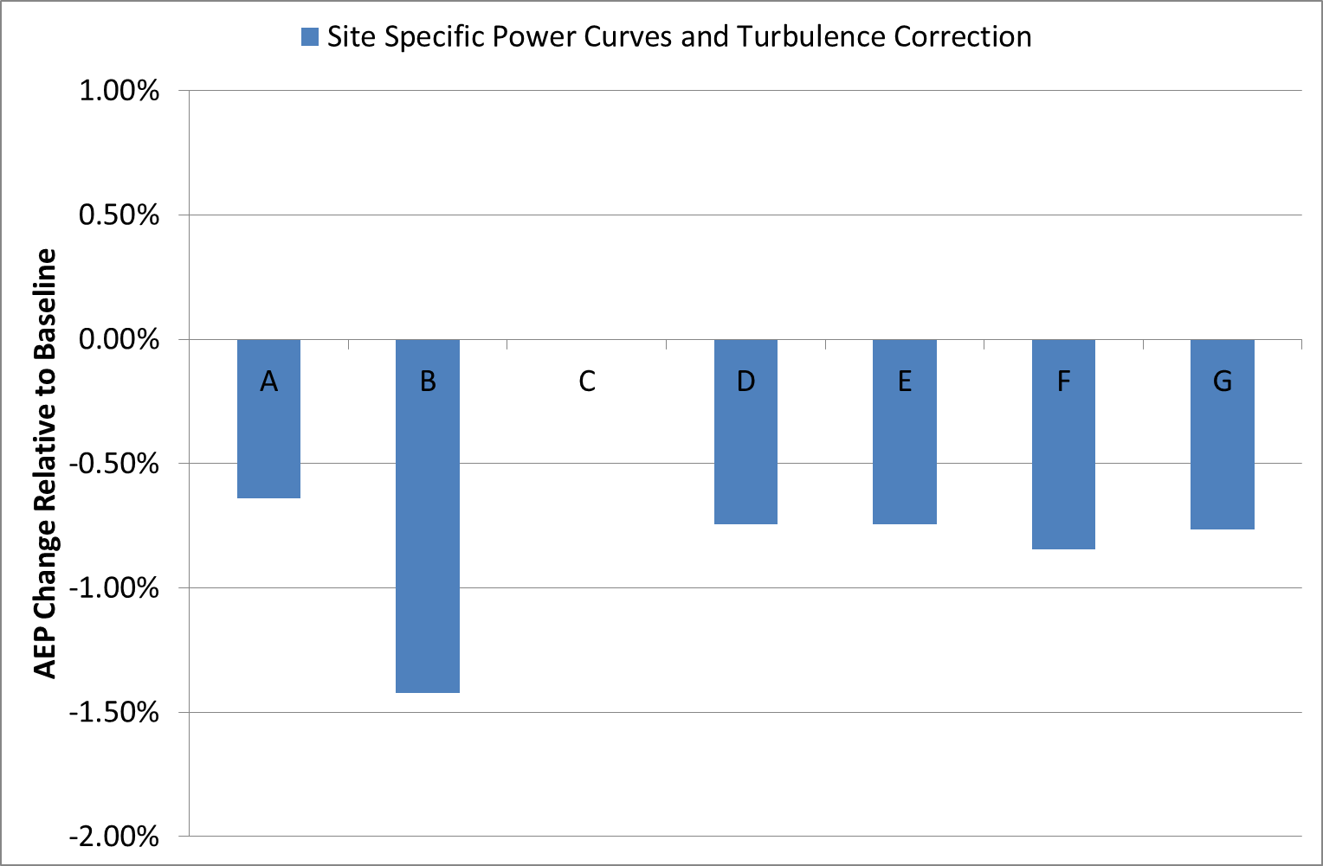
Exercise 4b – Site Specific Powers Curves & Turbulence Correction

